Slide 1
Using Exception Driven Development to build Rock-Solid Software
Blake Niemyjski
Notes:
Remote employee for over 10 years in various areas of Wisconsin.
Almost all of the work I do is open source, my main project that I run is Exceptionless
Always worked on solutions to help developers from commercial to open source software encompassing many different environments.
Private Pilot, Snow boarder, Bee Keeper & Husband

Slide 2

Notes:
I’d love for you to walk away getting value from this talk.
Companies have spent tons of money on EDD.
I work at one of them, Exceptionless
Please use an existing solution

Slide 3
What is Exception Driven Development?
Notes:
Simply the process of allocating resources toward fixing problems real users are having with your software based on data. You Collect this data through embedded Software.
You all are doing it, you just don’t know you are.
https://blog.codinghorror.com/exception-driven-development/

Slide 4
Collect Contextual Data
Fix Issues
Deploy Often
Notes:
The process is three simple steps

Slide 5
Why do I Care?
Notes:
Exception Driven Development solves many issues, I think it really helps solve problems before they become an even bigger issue.
I’m going to cover a few reasons why you should care.

Slide 6
Software has Bugs
Why do I care?
Notes:
Your going to ship with bugs even if you have:
extensive QA department
doing code reviews
code analysis.
Photo taken from: https://www.flickr.com/photos/usgsbiml/10329134756

Slide 7
Food for thought
The question isn’t how many bugs you will ship with, but how fast can you fix them?
Jeff Atwood
Notes:
There will always be bugs in software unless never ship
Jeff Atwood - Stack Overflow / Coding Horror

Slide 8
Average Bugs PER Line Of Code
AVG: 15-50 PER 1K LOC
Space Shuttle: 0 PER 500K LOC
Steve McConnell
Notes:
Again you gotta ship it.
http://www.mayerdan.com/ruby/2012/11/11/bugs-per-line-of-code-ratio
Steve McConnell - Code Complete

Slide 9
“If you're waiting around for users to tell you about problems with your website or application, you're only seeing a tiny fraction of all the problems that are actually occurring.
The proverbial tip of the iceberg.”
Jeff Atwood
Notes:
Users won’t always report the data (probably <1% (evangelists?? will tell you).
Did you lose the other 99%?

Slide 10
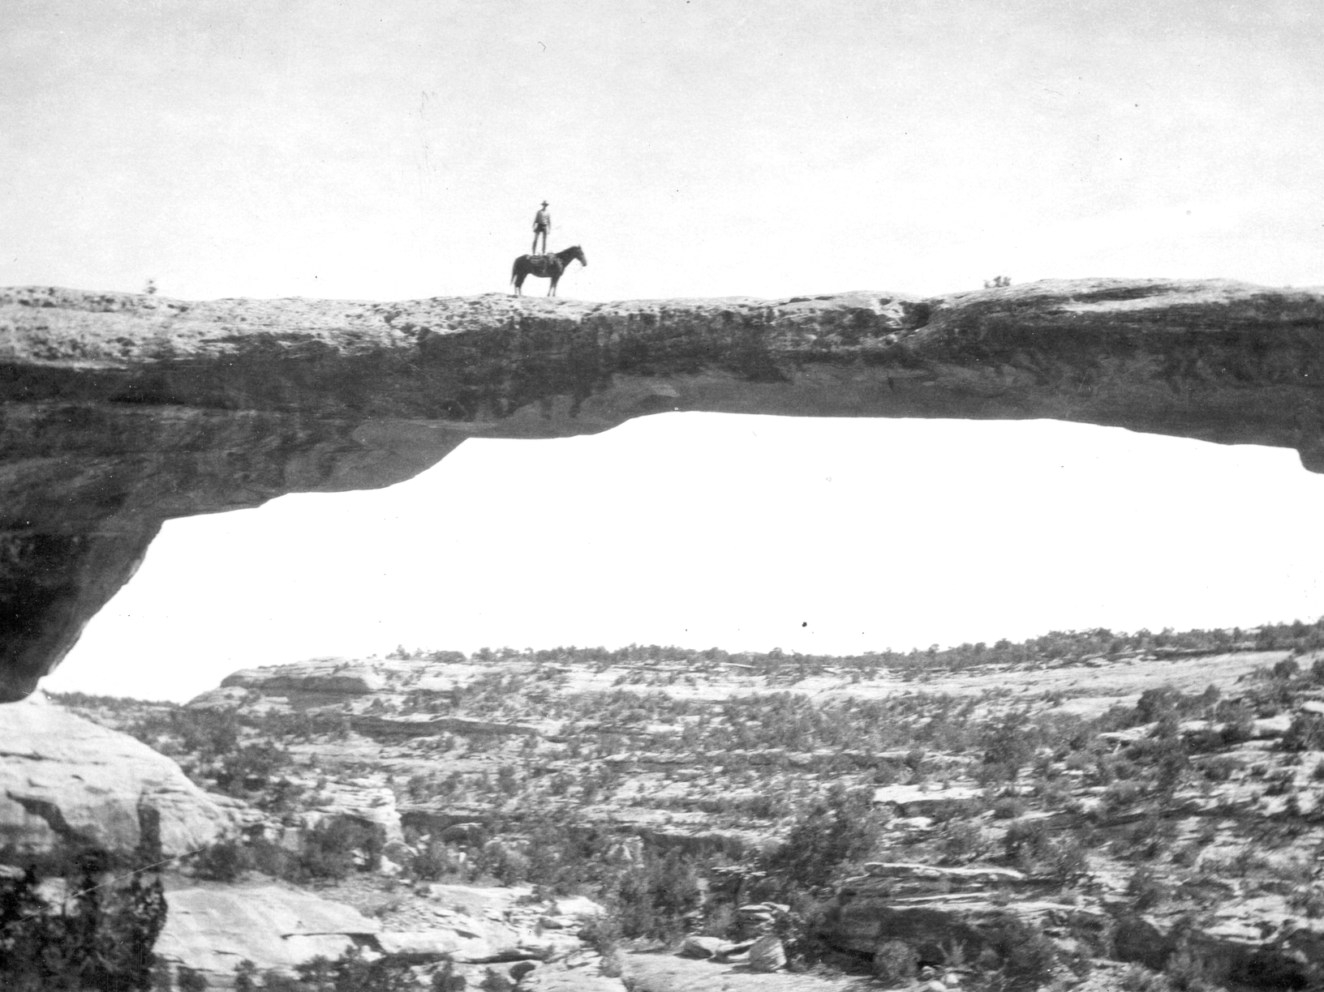
Trust the data**
Why do I care?
Notes:
if only 1% is telling you how do you know what’s going on?
The data will tell you what’s going on
make sure you are collecting everything you can.
The data is customer feedback
Image taken from https://www.flickr.com/photos/usgeologicalsurvey/13990836601/

Slide 11
Increased Productivity
Why do I care?
Notes:
Focus on what matters: Fixing top issues rapidly and working on new features
Photo taken from: https://www.flickr.com/photos/misco910/413731539

Slide 12

Notes:
Don’t spend extra time with tech support by asking users:
What version are you running?
When did you first notice this?
Can you tell me how to repro?
Tell me about your environment?
How did you start the application?

Slide 13
Brand Image
Why do I care?
Notes:
the impression of a product held by real or potential consumers.
What will your customers think when they have an issue?
Do you think they will come back (only ~16% will)?
Do you think they will refer you to someone else?
Saves money by increasing customer conversions.
Photo taken from https://www.flickr.com/photos/ajc1/11706363473

Slide 14
Summary
Why Do I care
All software has bugs
Trust the data*
Increased productivity
Improved brand image

Slide 15
Collect data
Step 1
Notes:
SHIP IT!!
Get as many users using it as possible.
Different ways to collect data and there are different types of data

Slide 16

How do I know My app is preforming as expected?
Ask yourself
Notes:
You won’t know unless you have good logging and metrics

Slide 17
Ways To collect
Notes:
How do I collect enough of the good data?
Flow through tracing information as much as possible.
Log all the data

Slide 18
To Email
Logging
Notes:
Wading through hundreds of emails,
Emails are no longer important

Slide 19
Notes:
Taken from https://athomewithtech.files.wordpress.com/2014/11/email-overload.jpg

Slide 20
To Disk
Logging
Notes:
You've all seen this before
Do you scale?
Do you have credentials?
String worth of data
Bottomless pit

Slide 21

Notes:
Not to mention Log files can get really big and it’s hard to look at them

Slide 22
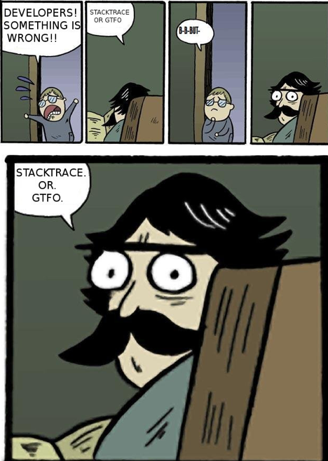
Notes:
How many times have you tracked down an issue with no contextual data.

Slide 23
Inhouse
Logging
Notes:
$$$$
Technical Debt
Supporting it
Photo taken from https://www.flickr.com/photos/floridamemory/5536778397

Slide 24
Food for thought
The danger in building internal tools is not that it saves insignificant amount of cash, but that it stifles future cash
Josh Pigford
Notes:
Do you want to be working on features or sidelined on a solved problem?
https://baremetrics.com/blog/build-it-buy-it

Slide 25
So what should I use?
Notes:
The answer is simple

Slide 26
Third Party Solutions
Logging
Notes:
Beware of vendor lock in (use abstractions)!
Use something that has options (self hosted or maintained)
Use existing solutions that are actively maintained and preferably has rich notifications.

Slide 27
Options
Exceptionless
Starting at $15, Free to self host
RAYGUN
Starting at $250
Application Insights
Starting at $15/node, Azure only

Slide 28
What is Exceptionless
Exceptionless
Open Source (MIT)
Detailed error reports
Real-time view as events occur
Rich notifications

Slide 29
Notes:
Breakdowns of how often and how many are affected. This data is put into categories to easily see what to fix

Slide 30
Notes:
Stacking duplicate exceptions
Know if you are getting better or worse overtime

Slide 31
Notes:
Rich Contextual Information (That stuff you didn’t need to ask the user for)

Slide 32
Notes:
It’s not just about capturing the errors but all meta data

Slide 33
DEMO TIME!!!
Step 1
Notes:
Setting up and configuring a new exceptionless project and asp.net core application
Overview of an existing sample project
View how existing logs are created
See if we can make the logs better
Check the logs to ensure we are logging
Art taken from: https://www.flickr.com/photos/ghodilated/3540159325

Slide 34
Summary
Collect Data
Ship software
Collect contextual data

Slide 35
Fix The Issues!!
Step 2
Notes:
Of course this is obvious that there are issues and they need to be fixed but what should you focus on?
Photo taken from https://www.flickr.com/photos/giuseppemilo/15414290956

Slide 36
What should I Focus on?
Notes:
Use the data to find your problematic code.
Prioritize your errors based on
number of occurrences
users affected
low hanging fruit

Slide 37
“Broad-based trend analysis of error reporting data shows that 80% of customer issues can be solved by fixing 20% of the top-reported bugs. Even addressing 1% of the top bugs would address 50% of the customer issues.”
Windows Error Reporting Service
Notes:
Let this sink in for a second!

Slide 38
Fix the top three errors!!!
Notes:
Focus on top issues affecting users, but don’t exclude exceptions not effecting users.
There could be services causing issues.

Slide 39

Prevent Regressions
Add Tests
Notes:
And also to ensure you didn’t break anything else.
Remember these bugs slipped through:
Existing Tests,
QA,
code reviews and analysis
And finally 99% of users probably ran into this issue and never told you about it.

Slide 40
DEMO TIME!!!
Step 2
Notes:
Demo how to fix bugs from the logs we have.
Prioritize your errors based on
number of occurrences
users affected
low hanging fruit

Slide 41
Summary
Fixing Issues
Look at the data
Fixing the top THREE issues
Add tests

Slide 42
Deploy again
Step 3
Notes:
From the users’ perspective, you’ll have a rock solid application in a handful of iterations.
Image taken from: https://davidjellison.wordpress.com/2013/10/13/saas-deployment-fail/

Slide 43
Deploy every Bug fix
Notes:
If continuous integration succeeds send that baby way.

Slide 44
Follow Up With Customers
Notes:
They will love you for it.

Slide 45
RinSE And Repeat
Notes:
They will love you for it.

Slide 46
Summary
Deploy Again
Deploy often
Follow up with end users
Fix more bugs!
Have rock solid software
Notes:
You’re already doing it and you just don’t know

Slide 47
Profit!
Step 4
Notes:
Repeat the process and iterate rapidly.
From the users’ perspective, you’ll have a rock solid application in a handful of iterations.

Slide 48
@BlakeN
github.com/niemyjski
exceptionless.com
Blake Niemyjski

